Slide 1

Quality management systems (QMS) for genomics
Respiratory Virus Genomics Workshop
15 September 2025
Ayanda Nzimande
Centre for Respiratory Diseases and Meningitis (CRDM)
National Institute for Communicable Diseases (NICD)
of the National Health Laboratory Service (NHLS)
Johannesburg, South Africa

Slide 2
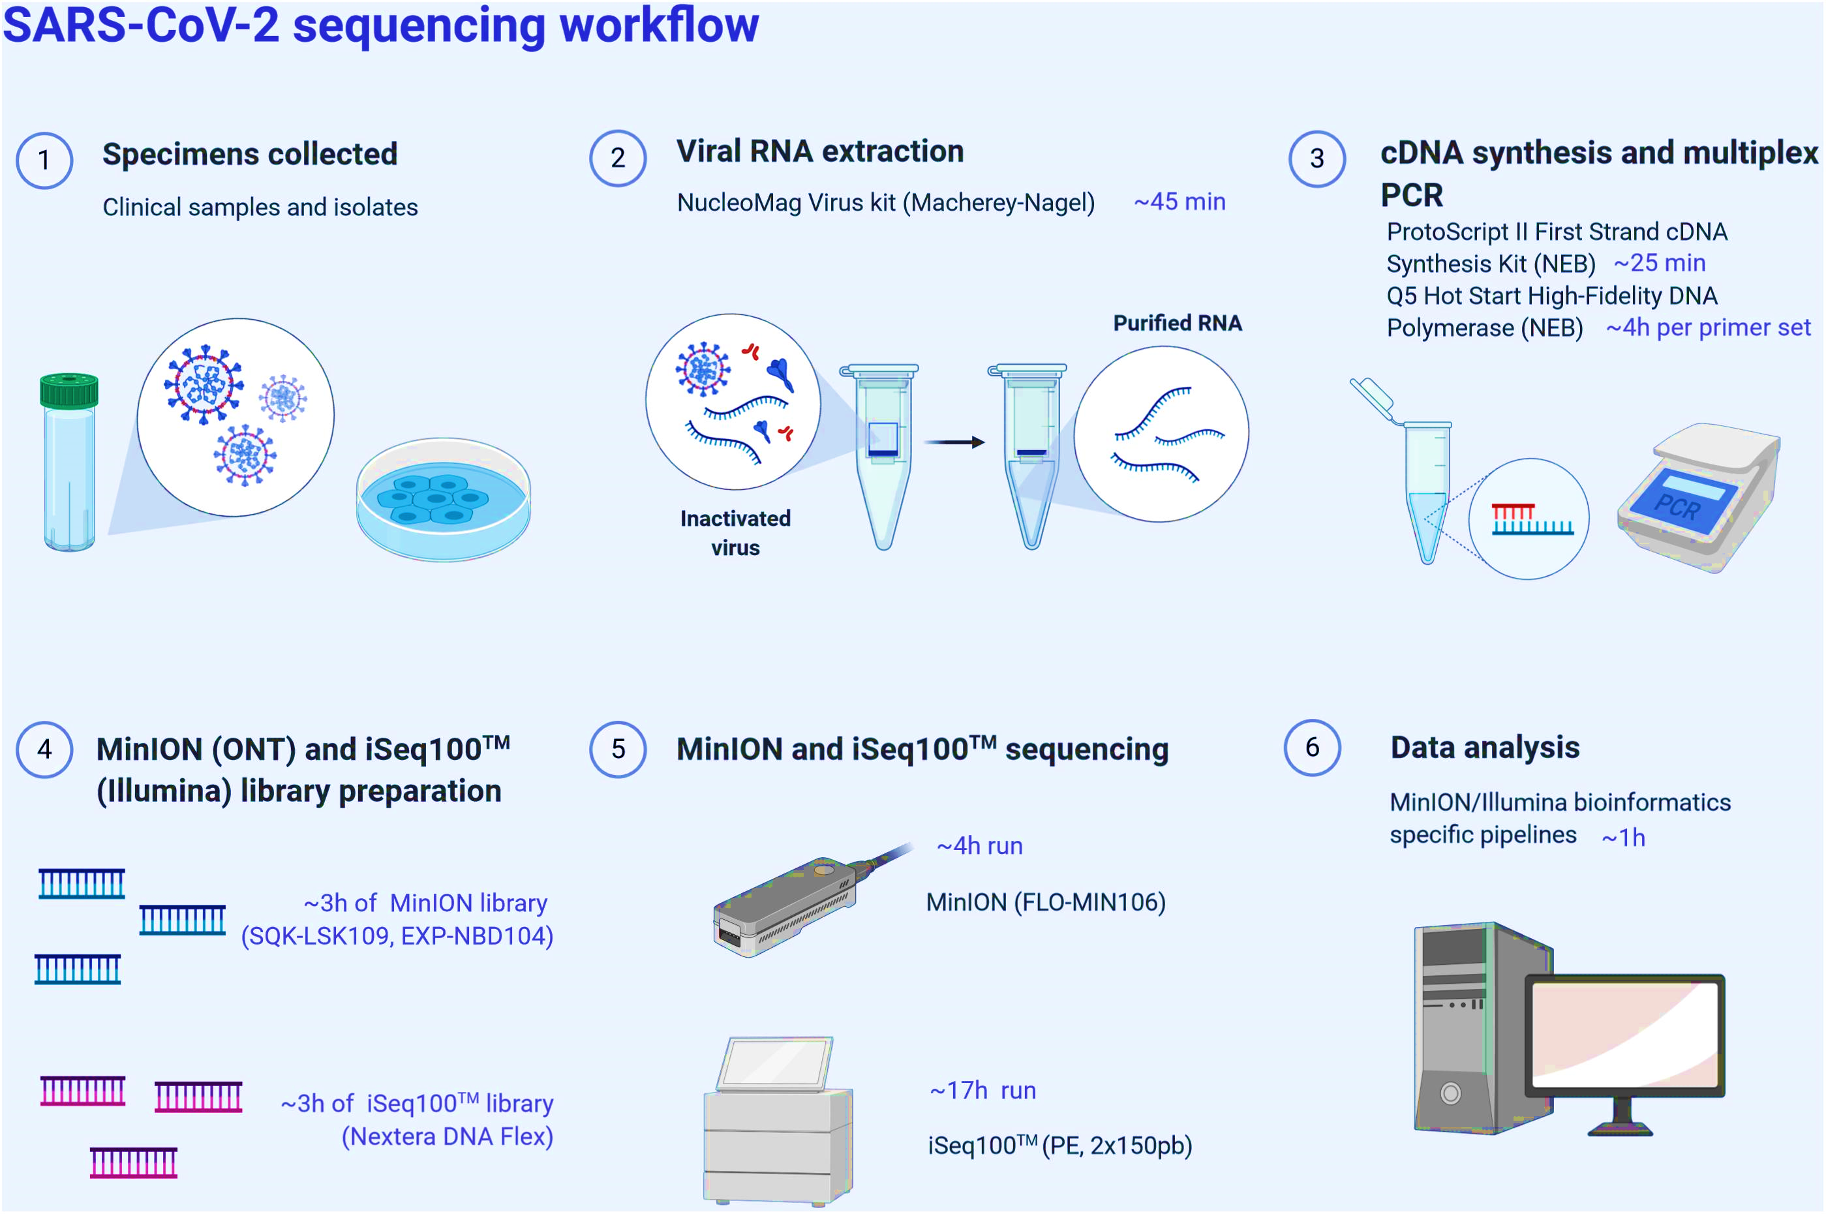
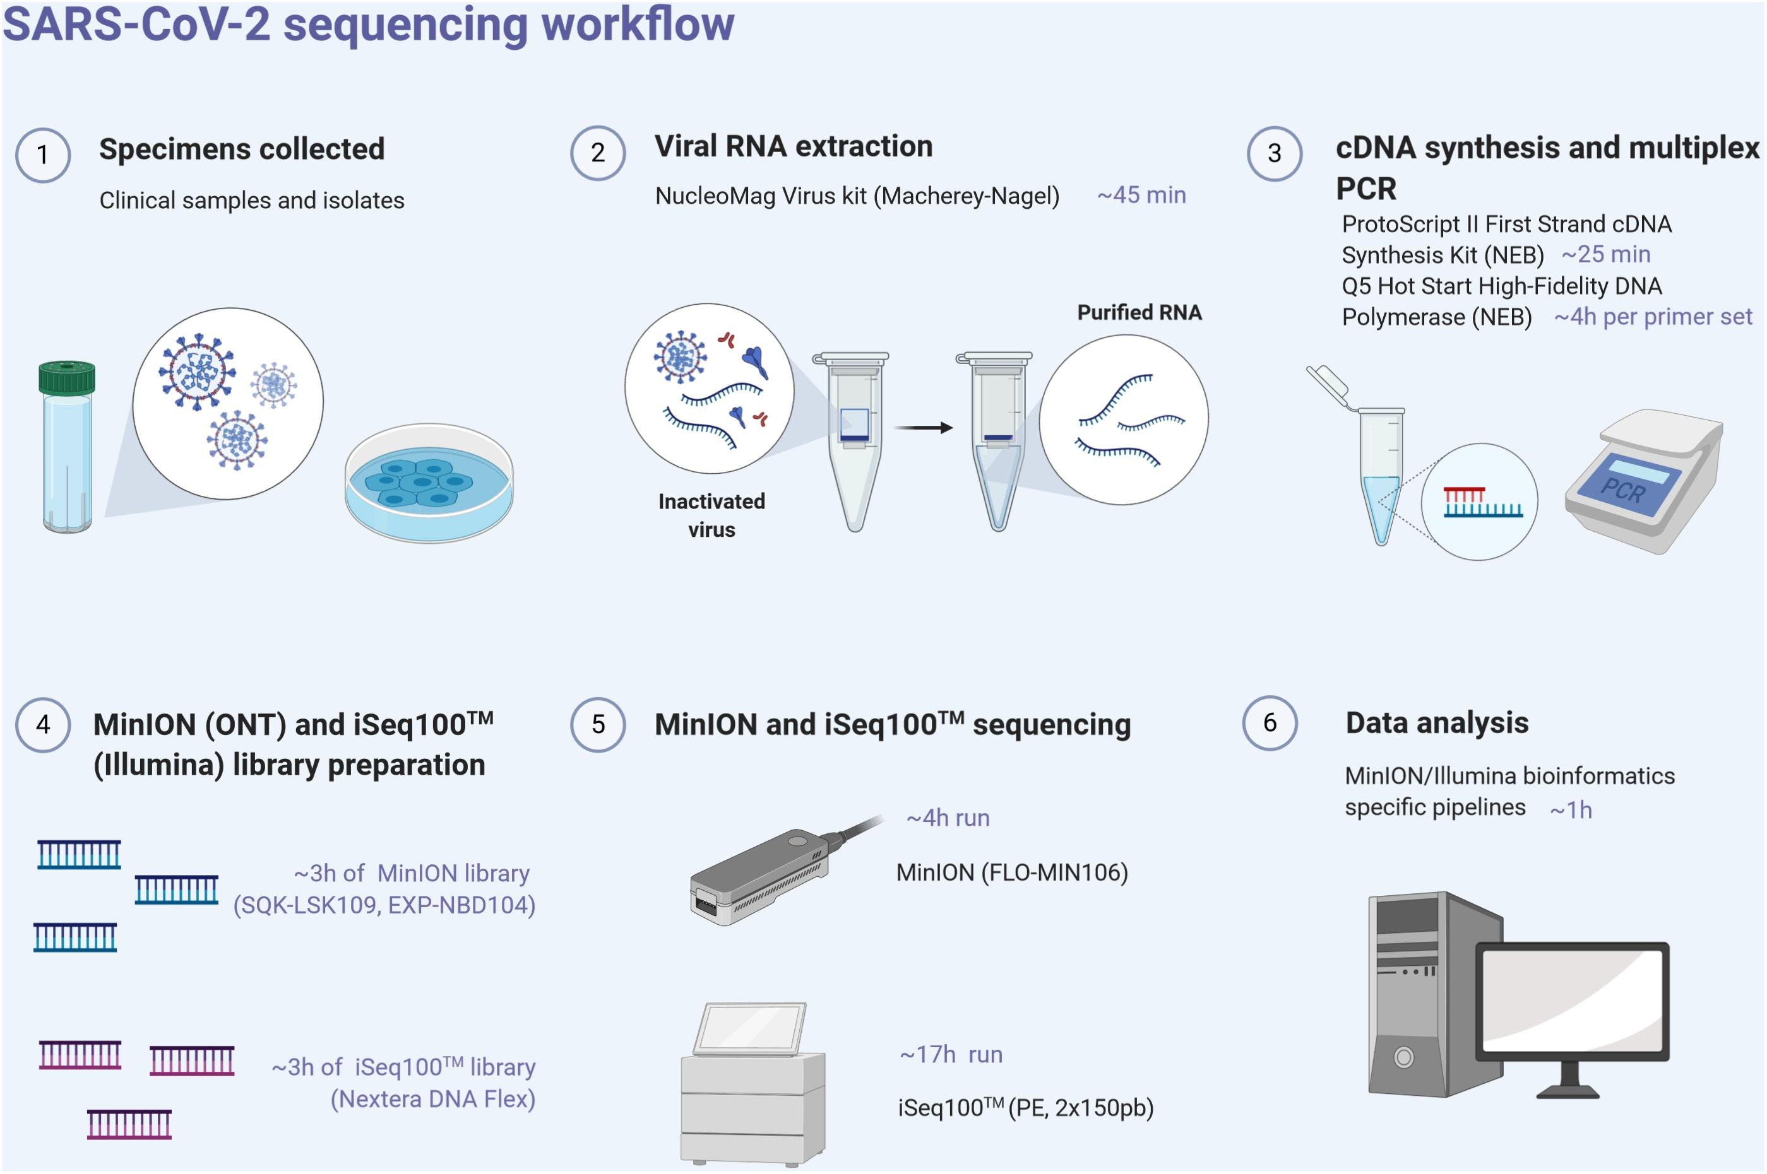
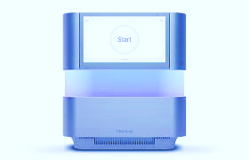
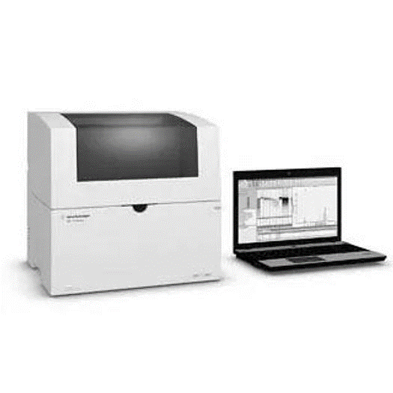
Overview: Wet lab sequencing workflow
SARS/ influenza/ RSV PCR⁺ respiratory specimen
Automated extraction
Using the Chemagic 360
RNA- cDNA synthesis and tiling PCR
Library preparation
Data analysis
Sequencing
Illumina NextSeq 1000/2000
Library quantification & QC
Tapestation 4200
Figure adapted from Hourdel et al, Frontiers in Microbiology, 2020

Slide 3
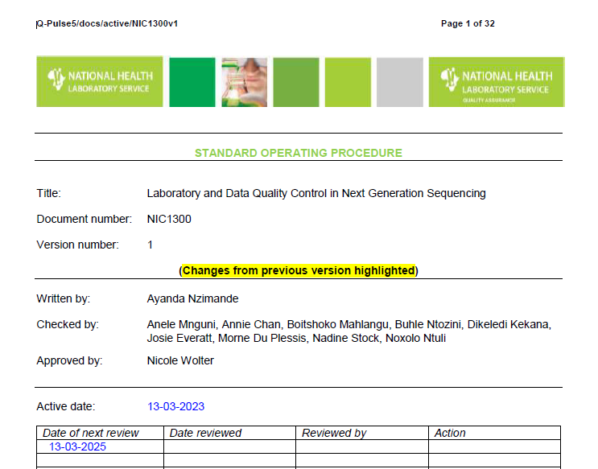

Slide 4
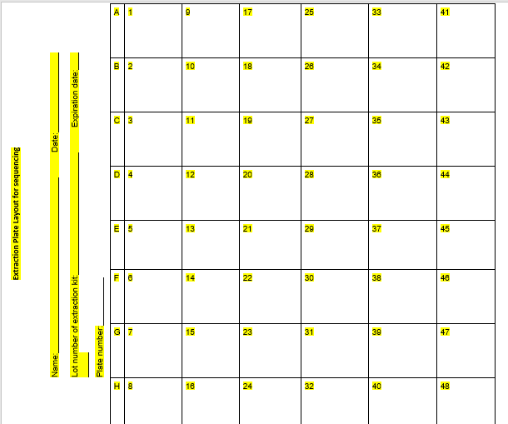
Extr Neg
Extr Pos
R01135/25
Amp Neg
Amp Pos
Kit +ve control
Lib Neg
Extr Neg
PBS
Lib Pos
R05241/25
Figure adopted from: Automated nucleic acid extraction for respiratory pathogens using the Chemagic® 360(NIC1300 on qPulse)

Slide 5
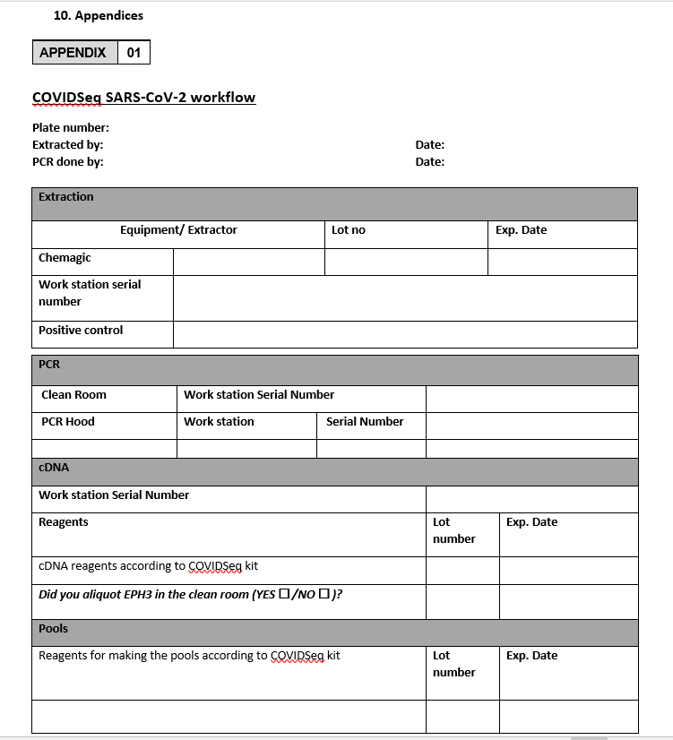
Figure adopted from: Laboratory and Data Quality Control in Next Generation Sequencing (NIC1300 on qPulse)

Slide 6
Covidseq SARS-Cov-2 workflow continued
Figure adopted from: Laboratory and Data Quality Control in Next Generation Sequencing (NIC1311 on qPulse)

Slide 7
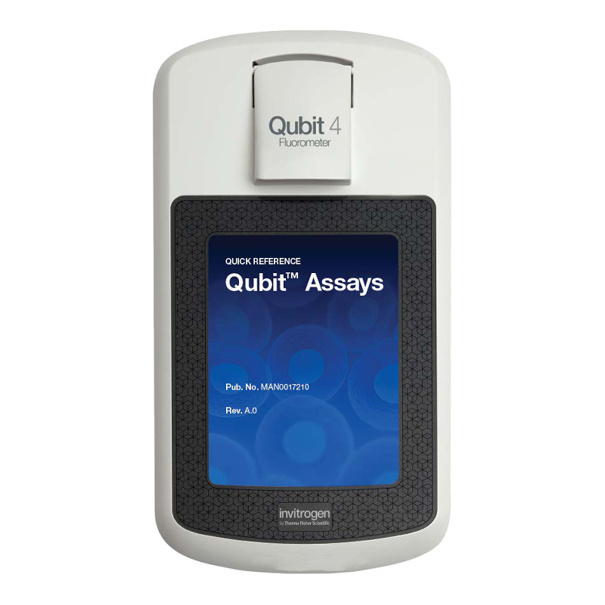
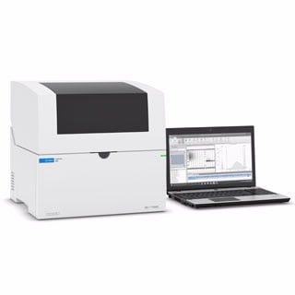
Table 1: Instruments used for quality control and library validation
 | Qubit® Fluorometer (2.0 or 3.0) is a small, portable instrument used for quantification of DNA, RNA and proteins in a sample. It uses fluorescent dyes that emit signals only when bound to specific target molecules (DNA or RNA). Qubit requires minimal sample volume and has better accuracy than the NanoDrop. The dsDNA High Sensitivity Assay can read sample concentrations from 10 pg/µL to 100 ng/µL.
 | The Agilent 4200 TapeStation system offers automated sample processing of ScreenTape applications for DNA and RNA at scalable and high throughput. The system includes the 4200 TapeStation instrument and a laptop. The credit card-sized, disposable ScreenTape device carries multiple separation lanes for analysing DNA and RNA samples. Each ScreenTape device has 16 lanes so that each sample is analysed in an individual lane, completely eliminating contamination and carryover.

Slide 8
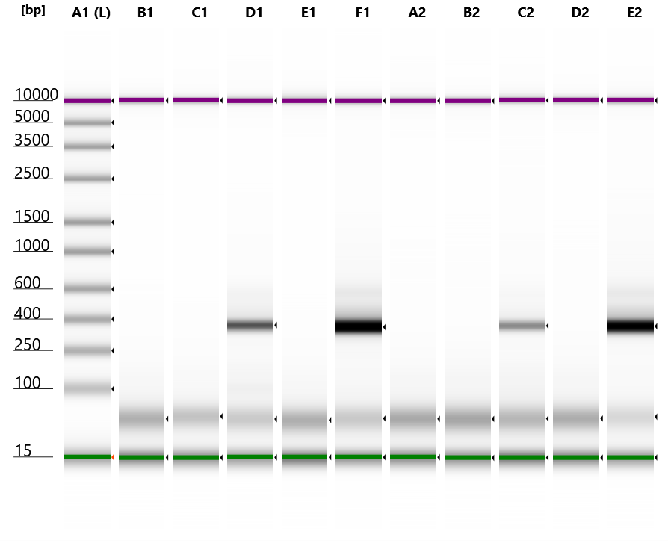
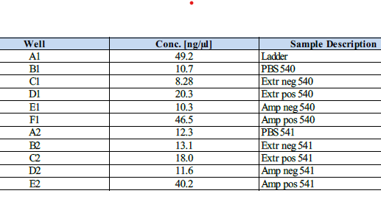
Fig 1: Gel view of the size distribution of negative and positive extraction and amplification controls on Agilent 4200 Tapestation.

Slide 9
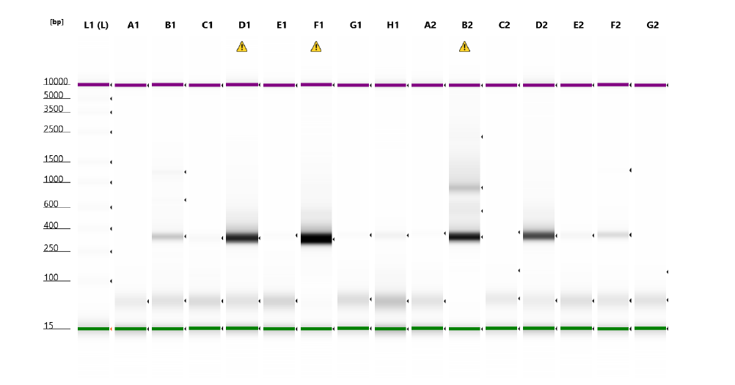
Fig 2: Gel view of the size distribution of negative and positive extraction, amplification and library controls on Agilent 4200 Tapestation (example of contaminated plates)

Slide 10
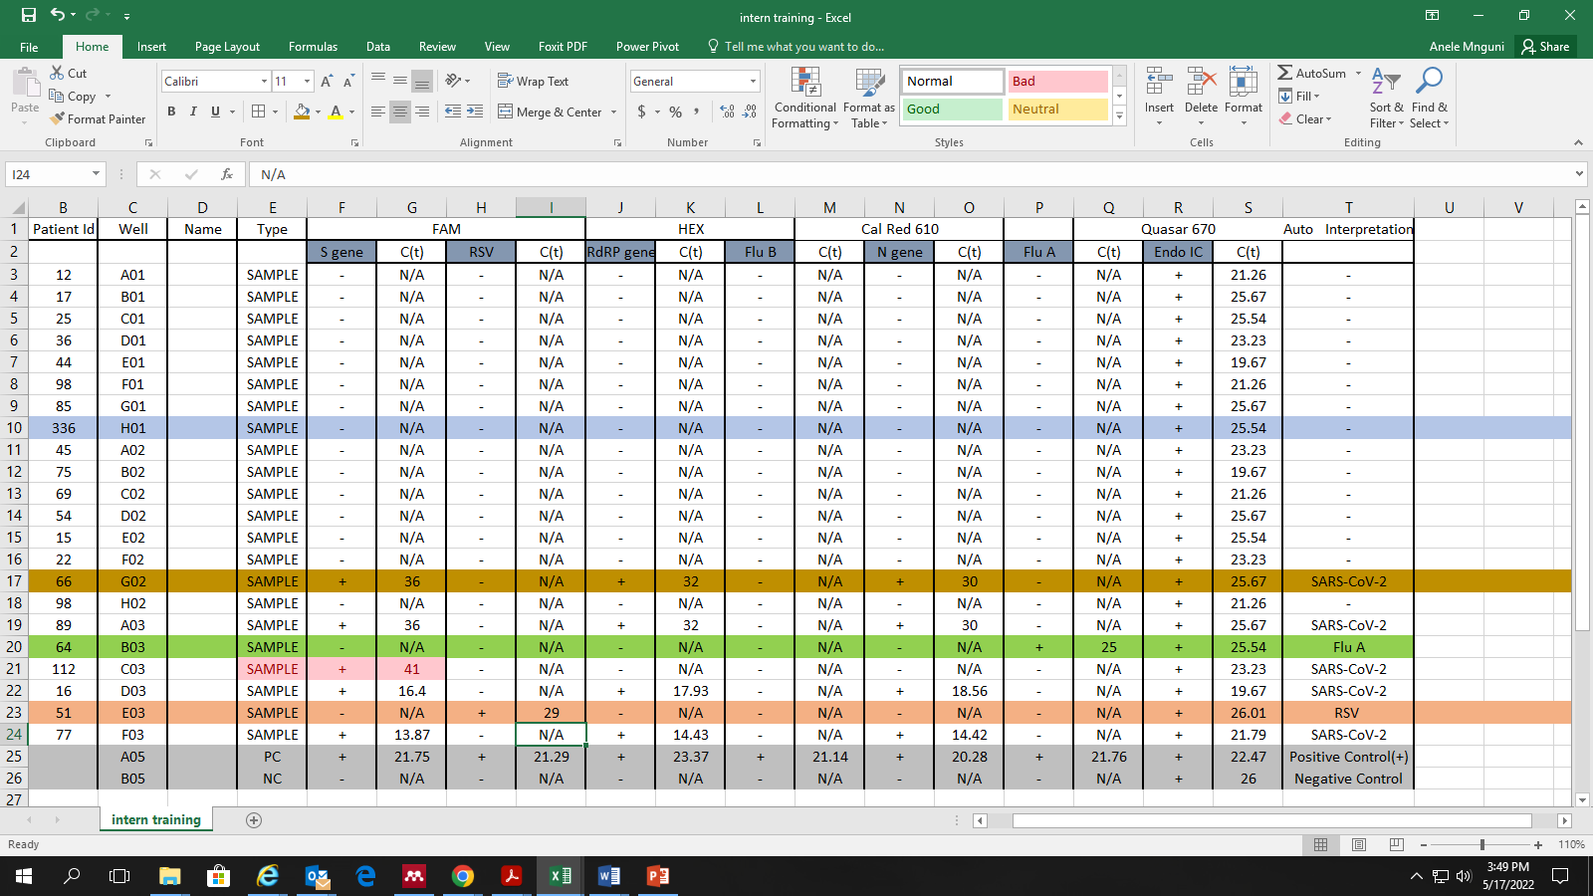
Water run

Slide 11
Environmental swabbing
Notes:
Move to excel presentation – sterile swabs used to swab high touch surface areas.

Slide 12
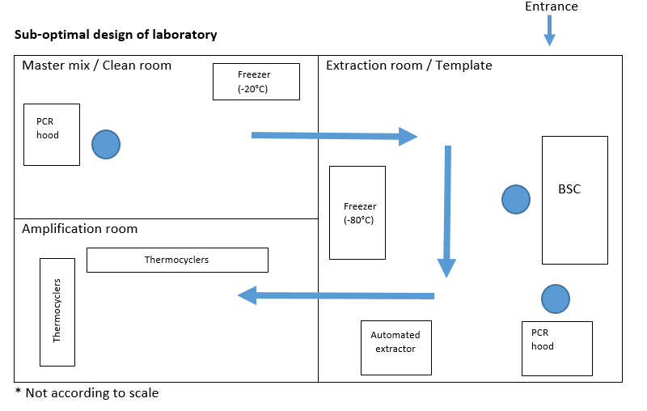

Slide 13
Extensive environmental cleaning
Notes:
Intensive cleaning of the surfaces, hoods, thermocyclers with 10% hypochlorite solution
, pipettes, literally with everything with Bleach, handy any, 70% ethanol and RNAse away

Slide 14
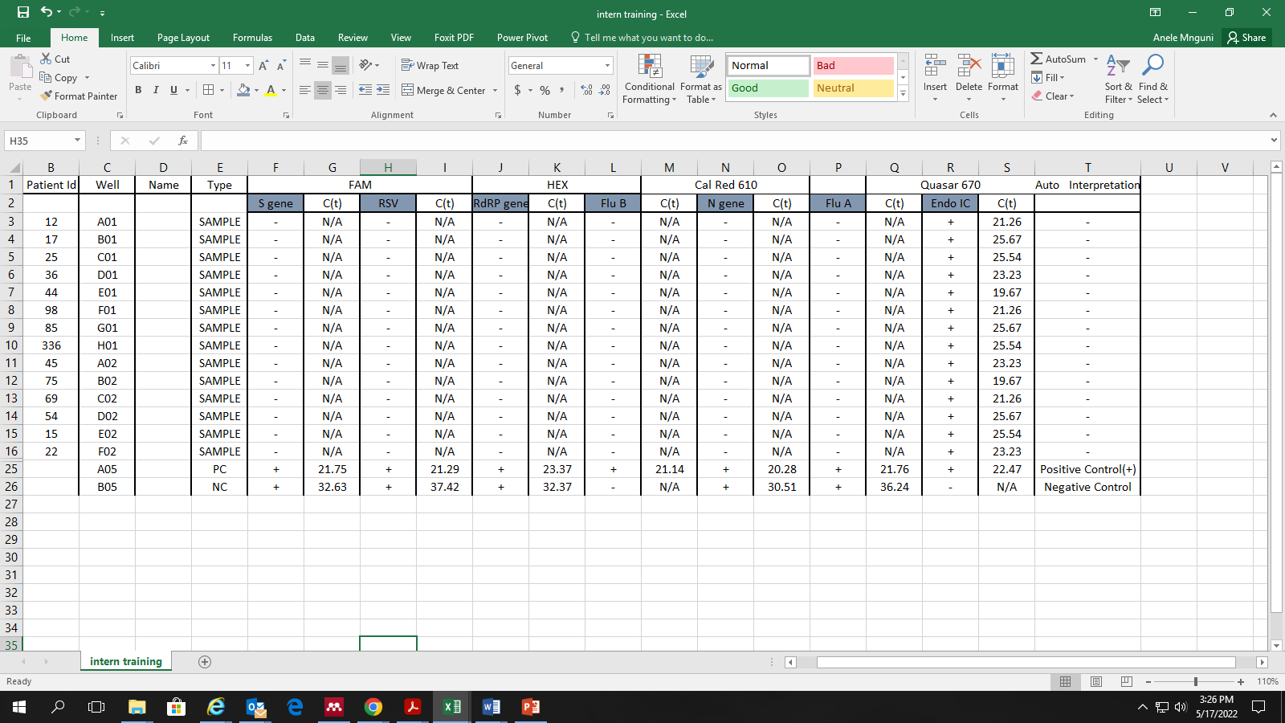
Repeat water run

Slide 15
How to mitigate/prevent contamination
Weekly water runs
UV lights
Unidirectional work-flow
Sterile conditions (i.e. filtered tips, frequently changing gloves, using aliquots)
10% hypochlorite solution
70% ethanol

Slide 16
QC - Bioinformatics
Are there any signs of contamination?
Examine negative controls- if you detect SARS-CoV-2, this indicates contamination
Did the sequencing work? How is the coverage on positive controls?
These are supposed to have high coverage as they are known previously sequenced samples with high coverage
If coverage is low – might be an indication that sequencing did not go well
Check if samples are also low coverage – if not, might just be problem with the control itself

Slide 17
QC – Bioinformatics
Negative controls
Copy raw data (fastq) from SCF
Negative control < 10% coverage
Pass
Upload to Exatype
No sign of contamination
Negative control 10-60% coverage
Examine controls
Stringent manual inspection (Nexclade)
Evidence of contamination
Disregard results
Resequence
Negative control
≥ 60% coverage

Slide 18
QC – Bioinformatics
Positive controls
Copy raw data (fastq) from SCF
Positive control is high coverage
Pass
Upload to Exatype
Analyze
Samples are high coverage
Positive control is
low coverage
Examine controls
Examine samples in the plate
Samples are low coverage
Sequencing failure
Resequence
Discard and log a non-conformance
Does not match original assignment

Slide 19
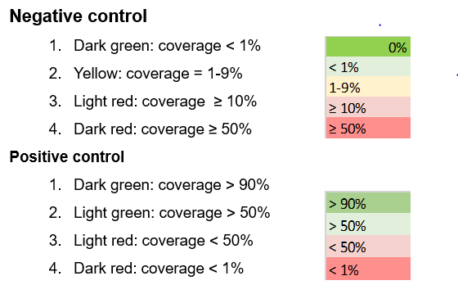
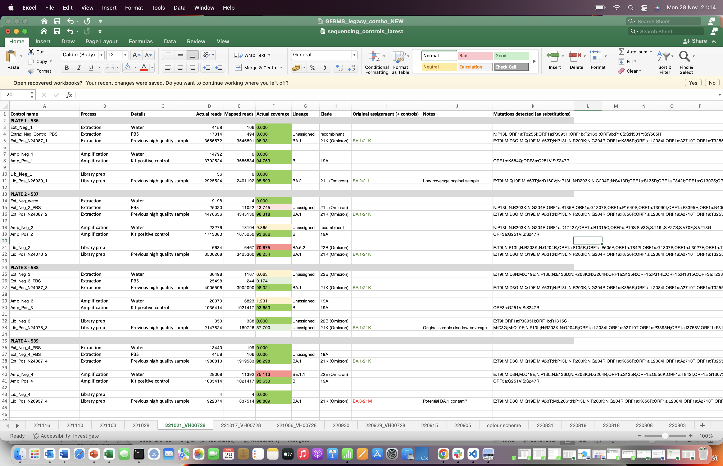
Interpretation
Examining controls
Neg controls clean
Pos controls high coverage
QC pass
Lib neg control contaminated (>60% coverage)
Discard plate
Neg controls clean
Pos controls high coverage
QC pass
Amplification neg control contaminated (>60% coverage)
Lib pos does not match original assignment
Discard plate

Slide 20
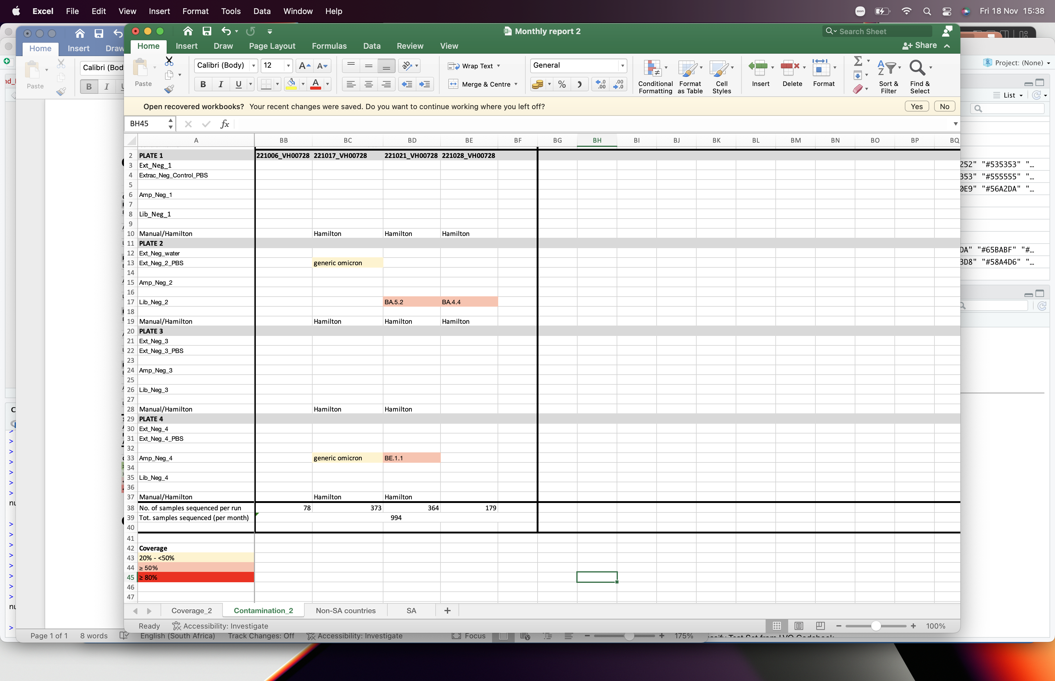
QC over time
Contamination on negative controls
KEY
How bad is the contamination
Is there a specific plate that is consistently contaminated
For the month in the example, contamination appeared to be more commonly detected on the second and the fourth plate for each run

Slide 21


Slide 22


